Slide 1
Genomic Variations and Phenotypic Effect Predictions
Ravichandran, S., Ph.D. saka.ravi@gmail.com

Slide 2
Agenda for today
Impact Analysis
Hands-on
SIFT
Polyphen-2
Hue Vuong (ABCC)
AVIA Tutorial
Hands-on

Slide 3
Hands-on
SIFT
http://sift.bii.a-star.edu.sg/
Click on “SIFT sequence”
“Upload example”
Polyphen-2
http://genetics.bwh.harvard.edu/pph2/index.shtml
“Batch Query”
Choose one or two of the examples (first & last one)

Slide 4
Pre-computed Predictions
Ensembl
Predictions readily available
Let us choose
BRCA2 http://useast.ensembl.org/Homo_sapiens/Gene/Variation_Gene/Table?db=core;g=ENSG00000139618;r=13:32315474-32400266
NCBI
ClinVar
https://www.ncbi.nlm.nih.gov/clinvar/variation/38241/

Slide 5
Highlights
Variation in a gene
Impacts the functioning of a protein?
Can we predict the impact using models?
Sequence-based approaches (SIFT)
Sequence+Structure-based approaches (PolyPhen2)

Slide 6
Basics
Whole genome sequencing
About 3.7 million SNVs in individual
The challenge is to identify causal from neutral variants
What do we know about disease-causing variants?
Rare; mostly in coding regions (1%)
Verification using experimental procedure is costly (time consuming) and not always conclusive

Slide 7
Limitations
Polyphen2
nsSNP (coding only)
“We specifically focus on nonsynonymous SNPs (nsSNPs), i.e., SNPs located in coding regions and resulting in amino acid changes in protein products of genes”
Taken from Current Protocols in Human Genetics 7.20.1-7.20.41, January 2013
SIFT
SIFT provides predictions for coding variants only

Slide 8
Variation impact modeling in publications

Slide 9
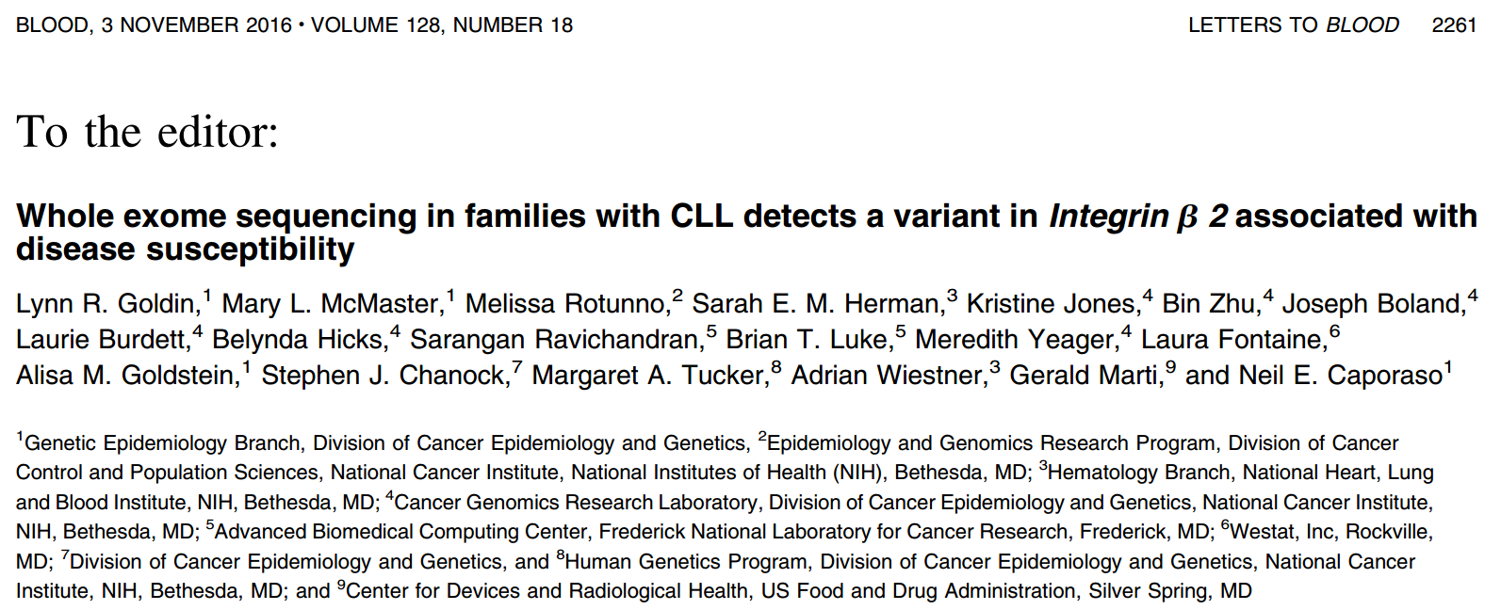
ITGB2: chr21:46308800: C>T; rs2230531 SWI5: Chr9:131038611: A>G

Slide 10
Steps the authors did
Sequence the genome
Align the reads
Identify the variants
Identify whether it is causal

Slide 11
Access to DB
Pairwise Alignment
BLAST
Advanced BLAST
MSA
Phylogeny/Trees
Eukaryotic Chromosome
NGS and Microarray
Protein Structure
Impact Analysis
Tools used in the publication

Slide 12
More publications that address genomic variations

Slide 13
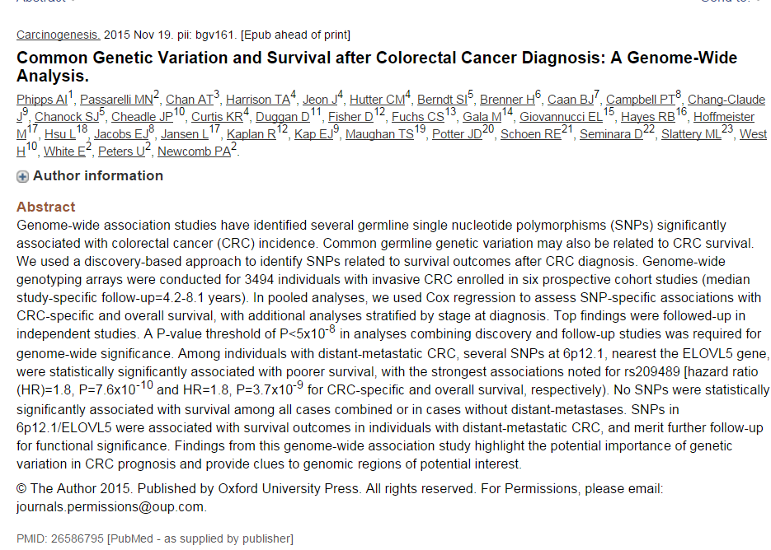

Slide 14
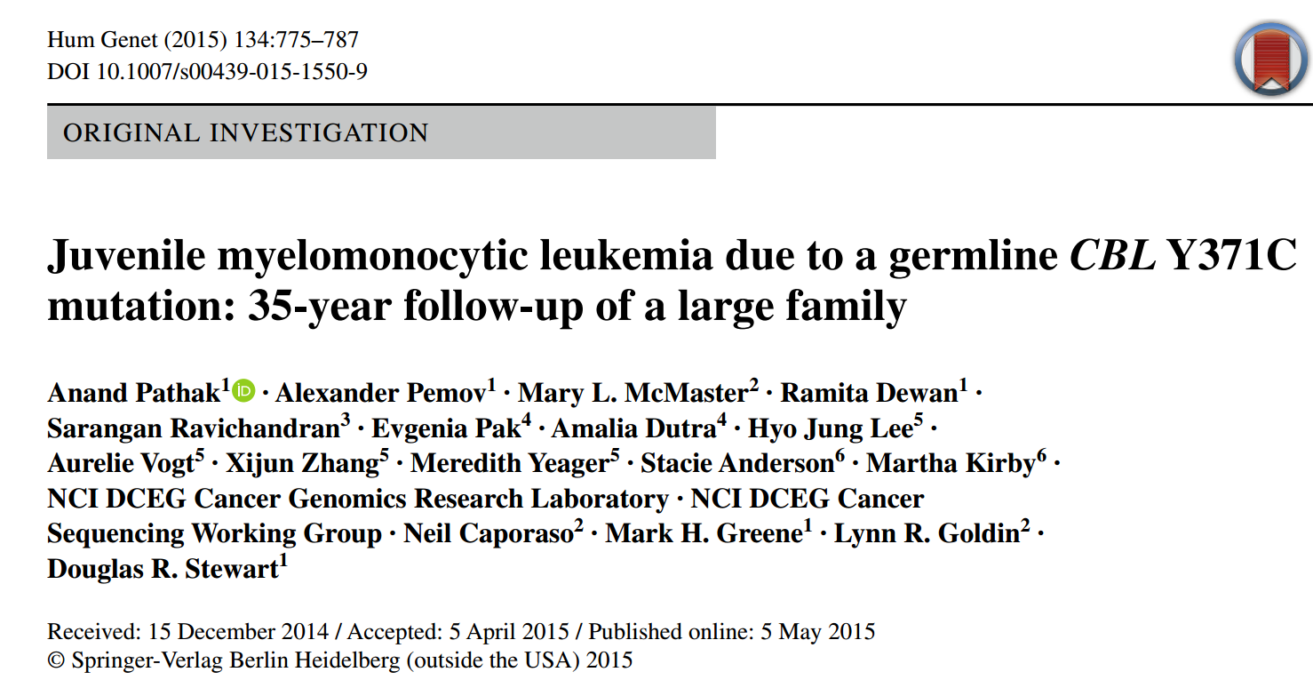
35-Years of follow-up and extensive analysis to identify a mutation that correlates with JMML

Slide 15
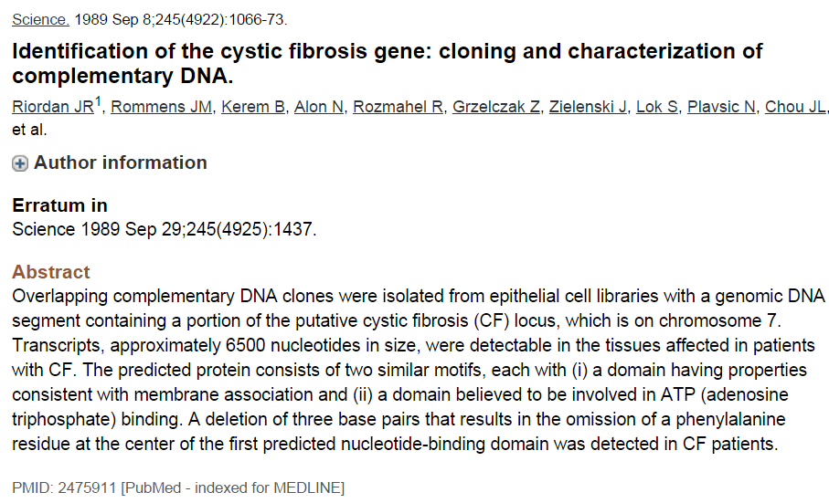

Slide 16
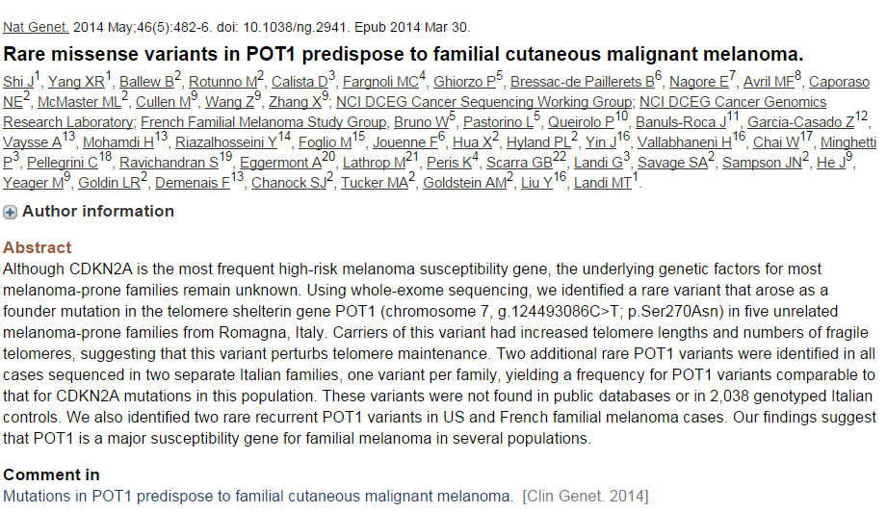

Slide 17
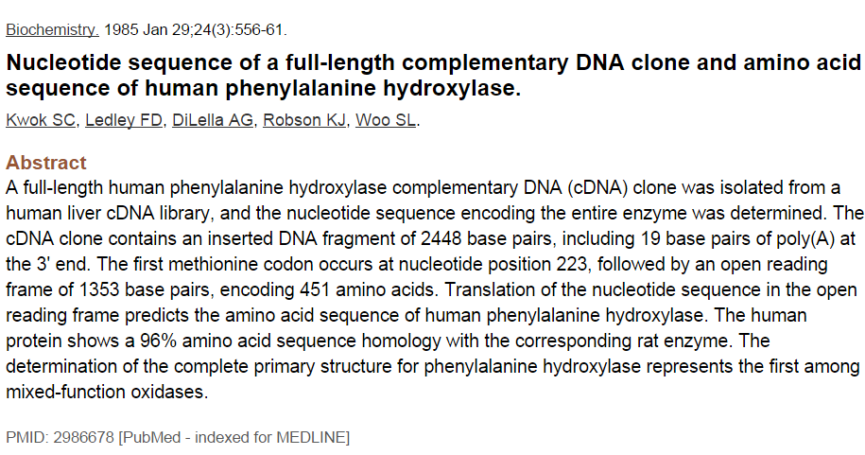
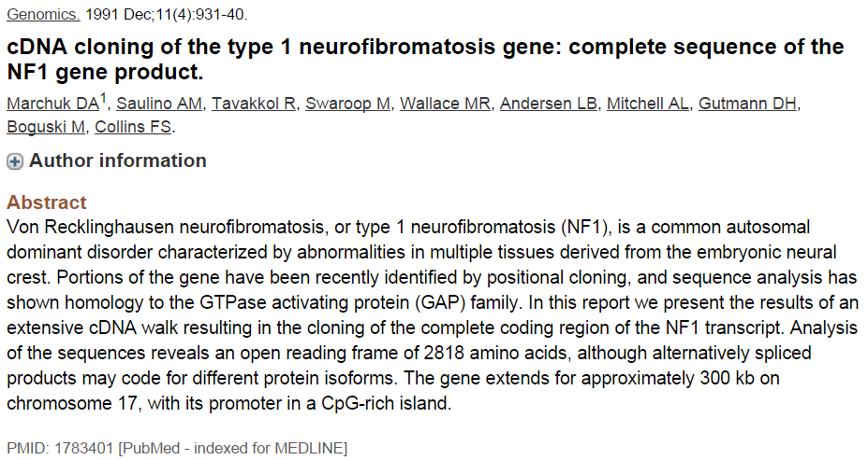
Disease Identification Papers
Time-consuming effort in the pre-genomic period

Slide 18
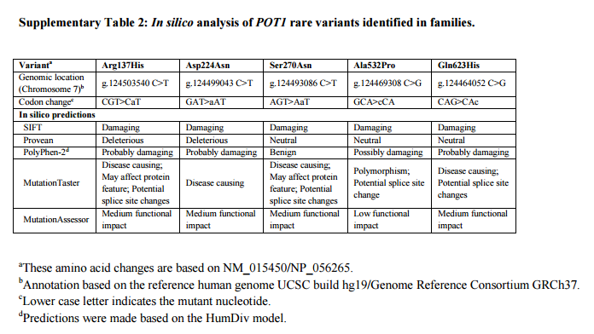
Variant Prediction Tools
Supplementary Table 2 Taken from Nat Genet. 2014 May; 46(5): 482–486.

Slide 19
If all non-conserved substitutions affect function then all of them can be predicted to affect the phenotype?
Proteins often have a high tolerance in accommodating many substitutions
BLOSUM matrices provide clues on tolerance

Slide 20
Precision Medicine
Impact Analysis is at the heart of Personalized Medicine
White-house initiative
https://www.whitehouse.gov/precision-medicine
Questions/Goal(s)
How to improve health and treat diseases?
How to move away from “Average Patient” approach?

Slide 21
Mutation databases

Slide 22
OMIM
Online Mendelian Inheritance in Man
McKusick-Nathans Institute of Genetic Medicine, The Johns Hopkins Univ. School ^{of medicine}
http://omim.org
Catalog of human genes and genetic disorders and traits
Contains genes and their phenotypes

Slide 23
OMIM
Source
Peer-reviewed material (biomedical)

Slide 24
dbSNP
http://www.ncbi.nlm.nih.gov/projects/SNP/snp_summary.cgi
Repository of short genetic variations (< 50 bp)
Not just SNPs
SNPs, short INDELs and more
Accepts data of common as well as polymorphic variations (neutral, known phenotypes and regions of no variation)
Somatic and germline variations

Slide 25
HGMD
The Human Gene Mutation Database
www.hgmd.cf.ac.uk/ac/index.php
Commercial

Slide 26
Examine a patient and compare the variation with some reference sequence and see a variation, can you call that as a causative variation?

Slide 27
Popular prediction methods are SIFT and PolyPhen-2. So, we will focus on the two for this lecture
TTTTAGTCTAC[G/A]ATAACC
Supplementaary Table 2 Taken from Nat Genet. 2014 May; 46(5): 482–486.

Slide 28
SIFT
http://sift.bii.a-star.edu.sg/
http://sift.jcvi.org/
Sorts Intolerant From Tolerant amino acid substitutions

Slide 29
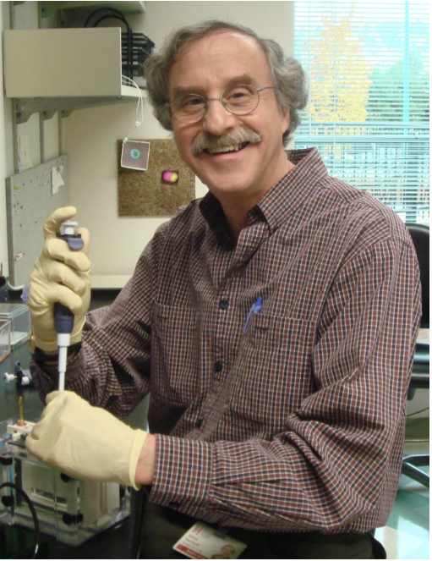
SIFT
S. Henikoff & J. G. Henikoff, "Protein family classification based on searching a database of blocks", Genomics 19:97-107 (1994).
PNAS, 104,50,19665-67
Steven Henikoff
History
Developed: Fred Hutchinson Cancer Center
Presently: SIFT Server in Singapore
Dr. Henikoff
BLOCKS
BLOSUM
BLOcks of Amino Acid Substitution Matrix

Slide 30
What Can SIFT Do For You?
Basic Idea: Evolution → Function
Mutation → Phenotype Effect
SNPs of Interest
Plan Functional Assay Expt.
SIFT can model phenotypic effects

Slide 31
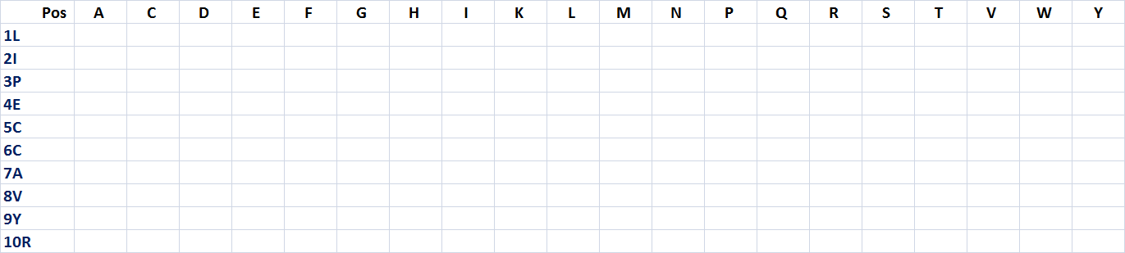
Procedure
Query
PSI-Blast
Alignment
Probability each pos
Normalize them SIFT Score
QUERY/1-22 LIPECCAVYR IQDGEKKPIG WD
1 UniRef90_B3DFX5/1-22 LIPECCAVYR VQDGEKKPIG WD
2 UniRef90_UPI00015B4F/1-22 LTTEMCVVYI VASNDKYPIP WD
3 UniRef90_UPI000051AA/1-22 LTTEMCVVYI LADNSRYLTS WD
4 UniRef90_E0VW01/1-21 LTPIMCDVYS VTFKNKK.IS WD
5 UniRef90_Q4R345/1-22 LIPECCAVYR IQDGEKKPIG WD
6 UniRef90_UPI00017588/1-20 LICEMCCVYL GDTNT..VVN WD
7 UniRef90_P11346-2/1-21 LTPDMCEVST THSG.RHIIP WH
8 UniRef90_UPI00016E32/1-22 LQPQCCAVFR LHPGKKLRMD WN
9 UniRef90_Q7Q2L5/1-20 LTCEFCEV.. TAGNSNYPIP WE
10 UniRef90_UPI0000E4A4/1-20 LTPEMCIVYR V..NPRMALS WD

Slide 32
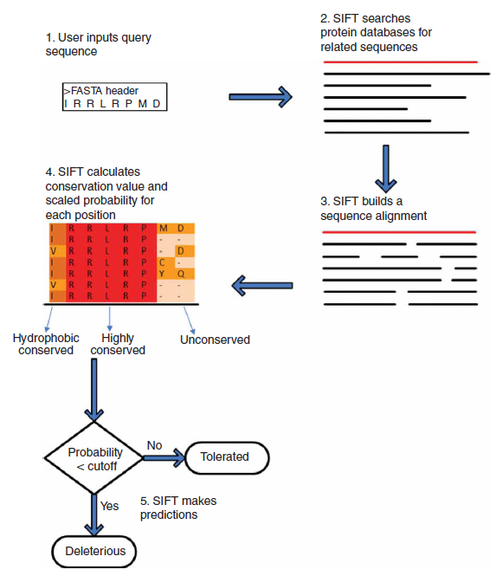
PSI-BLAST
Prob are normalized Using most freq AA
Scaled Prob. Matrix
Strictly conserved

Slide 33
Interpretation of SIFT Predictions
SIFT Score
Median Sequence conservation
Number of sequences at each column

Slide 34
Score
Normalized probability that the change is tolerated
0 0.05
0 to 1
Damaging: <= 0.05, Tolerated: >0.05
Threshold not always have to be 0.05
Scaled Probability
Sum of Scores .NE. 1
Arbitrarily chosen cut-off (95%)
Damaging (<= 0.05, Possibly Damaging [0.05-0.1]

Slide 35
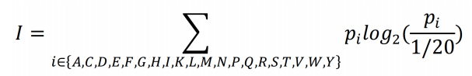
Median Sequence Conservation
Median Info
0 to 4.32 (ideally: 2.75 – 3.25)
Measure diversity of sequences
Information content at each position in the alignment is given by the following formula

Slide 36
Median Score Conservation
No Diversity; No New Information Homologues
LIPECCAVYR IQDGEKKPIG WD LIPECCAVYR IQDGEKKPIG WD
LIPECCAVYR IQDGEKKPIG WD
LIPECCAVYR IQDGEKKPIG WD
LIPECCAVYR IQDGEKKPIG WD
LIPECCAVYR IQDGEKKPIG WD
LIPECCAVYR IQDGEKKPIG WD
LIPECCAVYR IQDGEKKPIG WD
QUERY/1-22 LIPECCAVYR IQDGEKKPIG WD
UniRef90_B3DFX5/1-22 LIPECCAVYR VQDGEKKPIG WD
UniRef90_UPI00015B4F/1-22 LTTEMCVVYI VASNDKYPIP WD
UniRef90_UPI000051AA/1-22 LTTEMCVVYI LADNSRYLTS WD
UniRef90_E0VW01/1-21 LTPIMCDVYS VTFKNKK.IS WD
UniRef90_Q4R345/1-22 LIPECCAVYR IQDGEKKPIG WD
UniRef90_UPI00017588/1-20 LICEMCCVYL GDTNT..VVN WD
UniRef90_P11346-2/1-21 LTPDMCEVST THSG.RHIIP WH
UniRef90_UPI00016E32/1-22 LQPQCCAVFR LHPGKKLRMD WN
UniRef90_Q7Q2L5/1-20 LTCEFCEV.. TAGNSNYPIP WE
UniRef90_UPI0000E4A4/1-20 LTPEMCIVYR V..NPRMALS WD
LIPECCAVYR LQDGEKKPIG WD
Any Substitution Will be Damaging!
BRAF Protein
How do we measure diversity?
BRAF Protein sequence

Slide 37
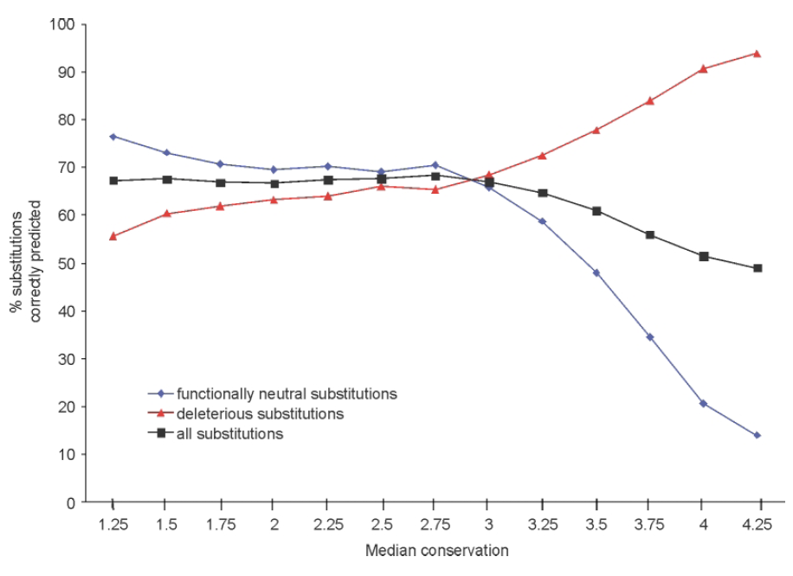
Median Score Conservation
What we need is diversity
How to measure Diversity?
0 – 4.32
Why 4.32?
Median Conservation
Confidence in prediction
SIFT Default
2.75 < Median Sequence Conservation < 3.25
Nucleic Acids Research, 2003, Vol. 31, No. 13
Highly conserved
0
4.32
Diverse Identical
less conserved

Slide 38
QUERY EQWFTEDPGP DEAPRMPEAA PPVAPAPAAP TPAAPAPAPS WPLSSSVPSQ
P04637 EQWFTEDPGP DEAPRMPEAA PPVAPAPAAP TPAAPAPAPS WPLSSSVPSQ
P13481 AQWLTEDPGP DEAPRMSEAA PHMAPTPAAP TPAAPAPAPS WPLSSSVPSQ
P56424 AQWLTEDPGP DEAPRMSEAA PPMAPTPAAP TPAAPAPAPS WPLSSSVPSQ
P61260 AQWLTEDPGP DEAPRMSEAA PPMAPTPAAP TPAAPAPAPS WPLSSSVPSQ
P56423 AQWLTEDPGP DEAPRMSEAA PPMAPTPAAP TPAAPAPAPS WPLSSSVPSQ
Q9TTA1 EQWFTEDPGP DEAPRMPEAA PPVAPAPAAP TPAAPAPAPS WPLSSSVPSQ
O36006 ENWF--DKGP DEALQMSAAP APKAPTPAAS TLAAPSPATS WPLSSSVPSQ
Q95330 ANWLNEDP-- EEGLRVPAAP APEAPAPAAP ALAAPAPATS WPLSSSVPSQ
Q8SPZ3 ANWL--DERP DEA-----PQ MPEPPAPAAP TPAAPAPATS WPLSSFVPSQ
Q9WUR6 ASWLGENPDG DGH----VSA APVSEAPTSA GPAAPAPATS WPLSSSVPSH
Q00366 AGWL-EDPGA AAAPAAPAAE DPVAETPA-- -PVASAPATP WPLSSSVPSY
Q9TUB2 TNWLDENP-- DDASRVPAPP -----AATAP APAAPAPATS WPLSSFVPSQ

Slide 39
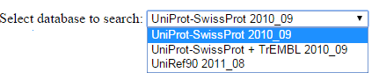
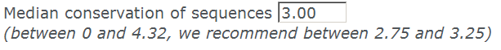
SIFT Sequence Search
http://sift.bii.a-star.edu.sg/
>HIV-1 protease PQITLWQRPLVTIKIGGQLKEALLDTGADDTVLEEMSLPGRWKPKMIGGI GGFIKVRQYDQILIEICGHKAIGTVLVGPTPVNIIGRNLLTQIGCTLNF
SNP Info: L10K
Which one?
At each position we calculate conservation and then compute median
Log2(0) to log2(20)
What is this?
My protein has 950 amino acids? Is that okay?
This cleans out any polymorphic alleles (sequences in the database that are nearly identical to your protein but already containing the substitutions of interest). The contaminating sequences may cause the substitution to be predicted as tolerated.

Slide 40
Also have to pay attention to…
Sequences at position
Number of sequences at this position.

Slide 41
Sample Variations
SIFT Aligned Sequences option was used SGI SIFT server was used (11/28/2015); Parameters chosen for this run: Sequence were aligned using SIFT Remove sequences more than 90 percent identical to query
SIFT
Gene Variation Pred(Score) MSC(SC)
BRAF D454E TOL(0.38) 1.96(254) A712T TOL(0.49) 1.96(250)
E695Q TOL(0.26) 1.97(254) CDKN2A R87P APF(0.02) 2.34(101)
Pred: Prediction MSC Median Sequence Conservation SC: Sequence represented at this position APF: Affect Protein Function

Slide 42
Hands-on
http://sift.bii.a-star.edu.sg/
Try loading a sequence and few variations of your choice

Slide 43
SIFT Reporting Style
Provide the following when you report SIFT findings
Used online server (Date)
What server? JCVI or Genome Inst. Of Singapore
What DB was used?
What input parameters were used?
WARNINGs
Did you remove What % sequence identical to your query?

Slide 44
SIFT Reporting Style
Provide the following when you report SIFT findings
Did you let SIFT do the alignments or did you supply your own alignments?
If you input your own alignments, explain how you got them?
Number of sequences used in the predictions

Slide 45
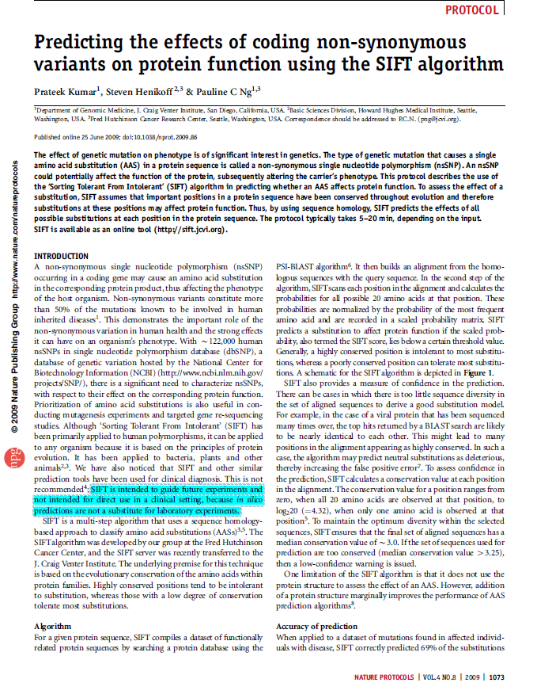
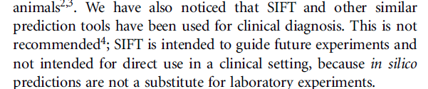
Disclaimer

Slide 46
Polyphen-2
Focusses on substitution site
Extracts Sequence/structure based properties
Phosphorylation, DNA Binding, 3D structure
Feed the information through a probabilistic classifier model
Model: Supervised Learning Model
Naıve Bayes classifier
Two pairs of Datasets were used for Training and testing
HumDiv and HumVar

Slide 47
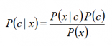
Naïve Bayes Approach
P(c|x), posterior probability
c: class (target) and x, attributes
P(c): Prior probability of class.
P(x|c) is the likelihood
probability of predictor given class.
P(x) is the prior probability of predictor.

Slide 48
Polyphen-2
Report the output
Benign, Affect function
Model have been tested on datasets and website provides estimation of models
ROC curves

Slide 49
PolyPhen-2 Databases
HumDiv:
UniProtKB: (All damaging alleles with known effects on the molecular function causing human Mendelian diseases) + (Differences between human proteins and their closely related mammalian homologs, assumed to be non-damaging)

Slide 50
PolyPhen-2 Databases
HumanVar
UniProtKB: All human disease-causing mutations + common human nsSNPs (MAF>1%) with no annotated involvement in disease (treated as non-damaging)

Slide 51
PolyPhen-2
http://genetics.bwh.harvard.edu/pph2/
My predictions were carried out on the online server (PolyPhen-2v2.2.2; 11/29/2015 ) using both Query Data and Batch Query Options
Input:
SwissProt ID(s) or fasta sequence with SNPs
Options allowed
Classifier Model: HumDiv or HumVar
Genome Assembly: GRCh37 or hg19
Transcripts allowed: All, Cannonical,Coding,
Annotations: All or Coding or Missense

Slide 52
Sample Variations
SIFT PolyPhen2
Gene Variation Pred(Score) MSC(SC) Pred(Prob)
BRAF D454E TOL(0.38) 1.96(254) BEN(0.002) A712T TOL(0.49) 1.96(250) BEN(0.000)
E695Q TOL(0.26) 1.97(254) BEN(0.330) CDKN2A R87P APF(0.02) 2.34(101) PRD(1.00)
MSC Median Sequence Conservation SC: Sequence represented at this position APF: Affect Protein Function
PPHEN2: HumDiv DB was used PRD: Probably Damaging; BEN: Benign; TOL: Tolerated

Slide 53
Polyphen-2
http://genetics.bwh.harvard.edu/pph2/bgi.shtml

Slide 54
PolyPhen-2 Code words: BEN: Benign;PRD: Probably-Damaging; POD:Possibly-Damaging
pph2_class probabilistic binary classifier outcome (“damaging” or “neutral”)
pph2_prob classifier probability of the variation being damaging
pph2_FPR classifier model False Positive Rate (1 - specificity) at the above probability
pph2_TPR classifier model True Positive Rate (sensitivity) at the above probability
pph2_FDR classifier model False Discovery Rate at the above probability
POD: Possibly Damaging; BEN: Benign; PRO: Probably Damaging
SIFT Code words:
TOL: Tolerant APF: Affecting Protein Function

Slide 55
Let us analyze one of the predictions
CDKN2A R87P Why SIFT and PolyPhen-2 Predicted this variation to be damaging?

Slide 56
Prop: Fraction of sequences that contain one or more basic amino acids at this position
SIFT
Polyphen-2 predicts this variation to be Probably Damaging with a Prob of 1.0
Are these two predictors viewing the variation in the same way? Let us analyze this mutation using both experimental and 3D structure information (PolyPhen-2).

Slide 57
Experimental Information

Slide 58
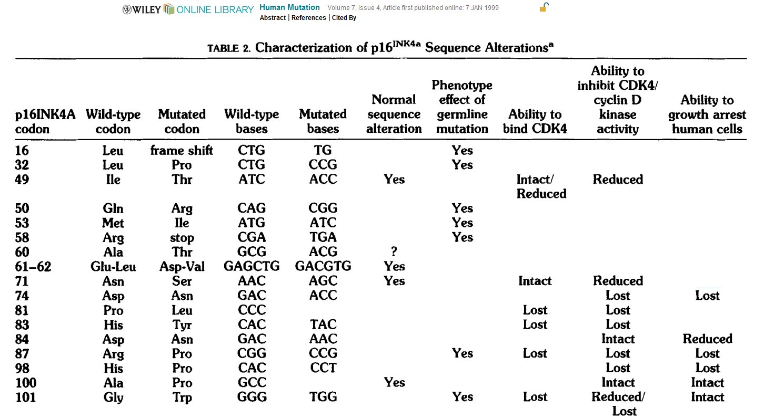

Slide 59
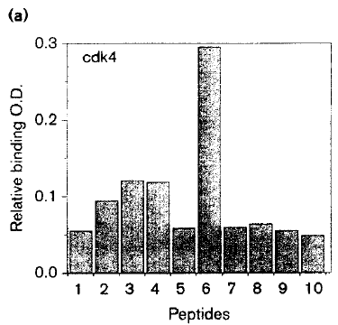
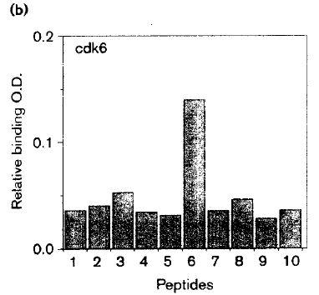
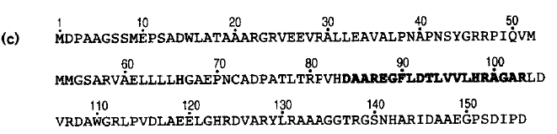
Fahraeus et al, Curr Biology, Vol 6, No.1:84-91 1996
Interaction of P16 (CDKN2A)-derived synthetic data with cdk4 and cdk6
Peptide 6 is shown in dark font

Slide 60
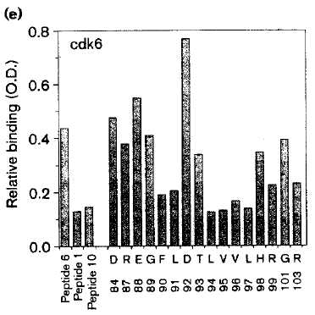
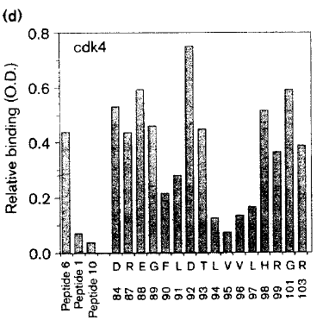
Fahreus et al, Curr Biology, 6,1:84-91 1998
Alanine Sub. Experiments

Slide 61
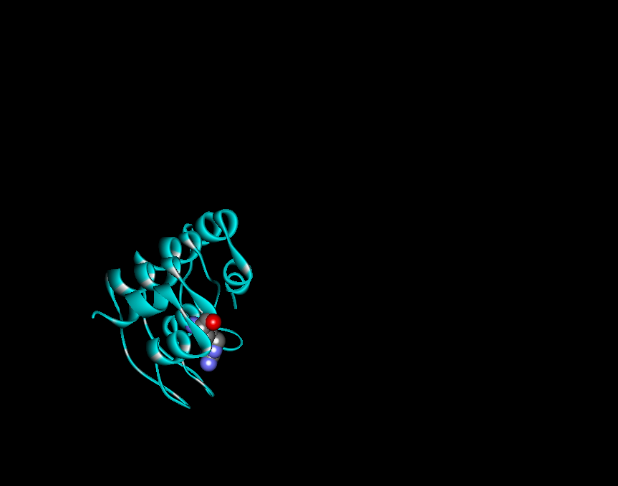
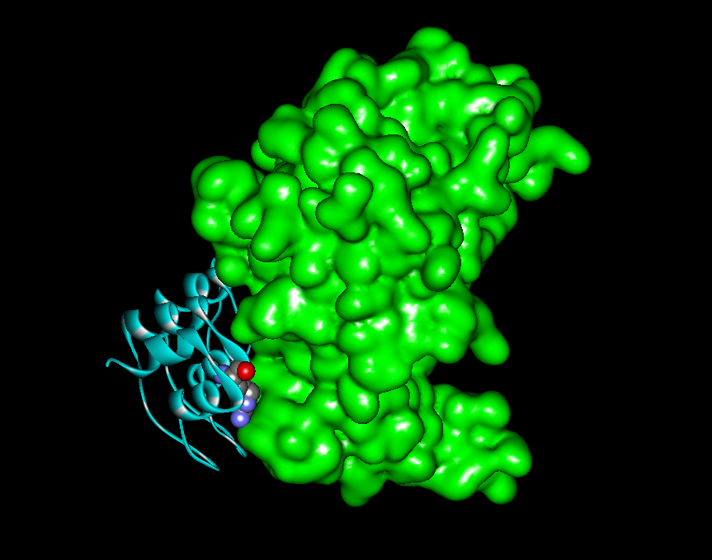
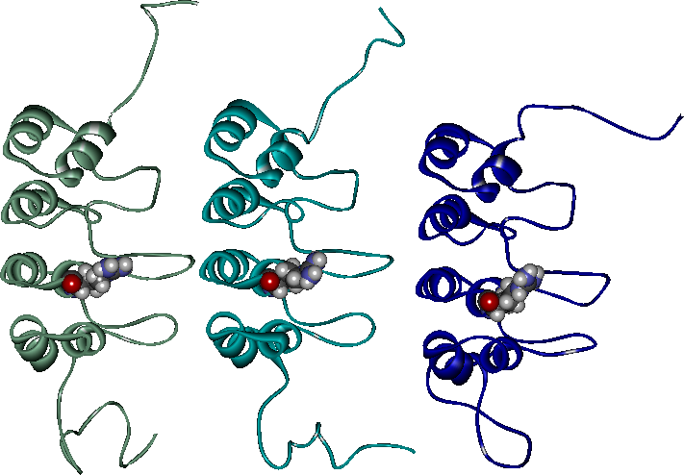
CDKN2A(R87P)
How can this substitution be bad?
CDKN2A
GREEN: Chain A-CDK6
2A5E 1DC2 1A5E

Slide 62
Second Example

Slide 63
HBB
E7V
In some papers you will see this as E6V
GRCh37
Chr11, 5248232A>T (w.r.t reference strand)
P68871; rs334, NP_000509
Negative gene
MutationTaster: Polymorphism
SIFT: Affect Protein Function (low Confidence)
PPHEN2: Benign

Slide 64
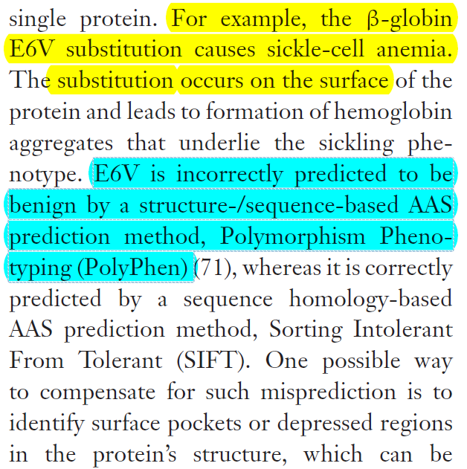
Pauline C. Ng and S. Henikoff, Annu. Rev. Genomics Hum. Genetics 2006, 7:61-80

Slide 65
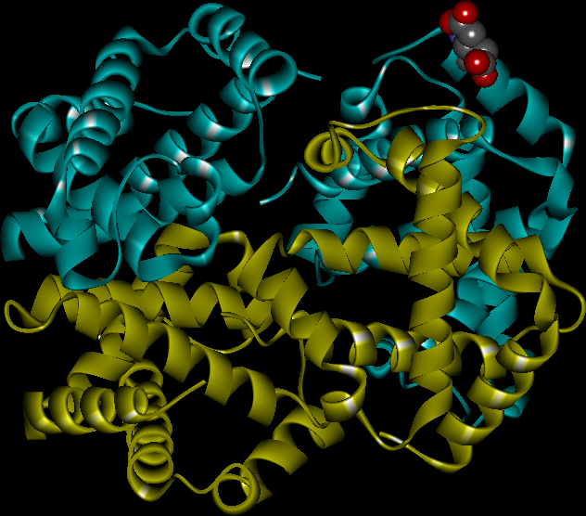
CYBB/Beta-Hemoglobin E→V → Sickle Cell Anemia
Human Hemoglobin
10 20 30 40 50 60
MVHLTPEEKS AVTALWGKVN VDEVGGEALG RLLVVYPWTQ RFFESFGDLS TPDAVMGNPK 70 80 90 100 110 120 VKAHGKKVLG AFSDGLAHLD NLKGTFATLS ELHCDKLHVD PENFRLLGNV LVCVLAHHFG
130 140 KEFTPPVQAA YQKVVAGVAN ALAHKYH
2w72(1.07)
HEME
(not shown)
Heterotetramer(2α and 2β)

Slide 66
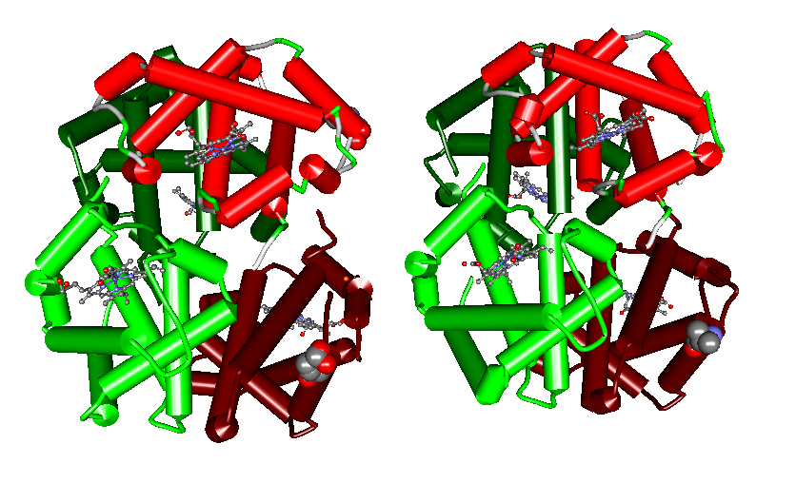
WT
E7V Mutant
E7
V7
V7
E7
4HHB
2HBS

Slide 67
Why Predictions are different?
Go back to the structure comparison and answer the following questions:
Does the mutation alter the structure?
Secondary structures are different?
Does the fold look different?
Where is the mutation located?
Buried-in
exposed

Slide 68
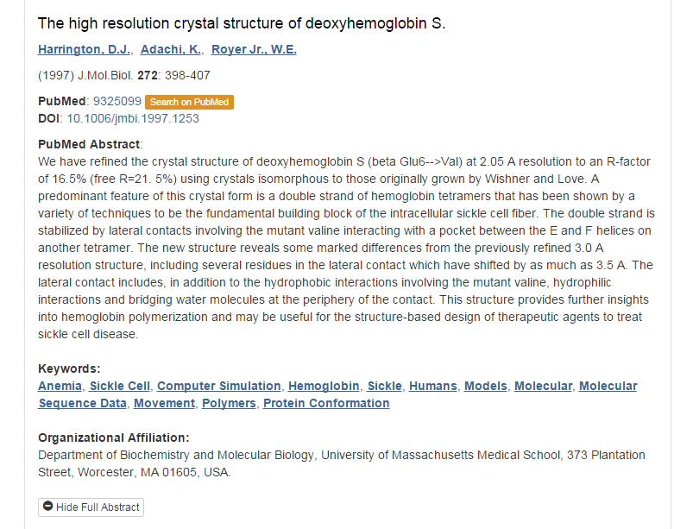

Slide 69
How Can We Take Full Advantage of SIFT?
Submitting specifically ORTHOLOGOUS sequences
Why is this important?
Imagine more sequences closely related in the alignment
Many positions will be conserved and so predict any normal sub to be bad!
Choosing proper cut-off (ex. 0.1 etc)
choosing right database in case of less confidence predictions

Slide 70
Most times you wont start with protein coordinates
Example
The explore the variation BRAF: A712D
You need
Chr7 140734763 G/T (GRCh37)
And not
Chr7 140734763 G/T (GRCh38)

Slide 71
Major Differences between SIFT and Polyphen-2
Disease mutations are mostly caused by structural instability
Orthologs and Paralogs
Polyphen-2 considers both
SIFT (sequence) Polyphen (seq/str)
Can sequence alignment bring out structural information?

Slide 72
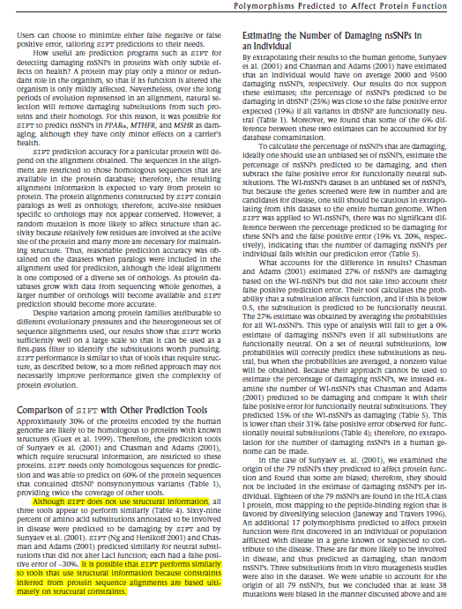
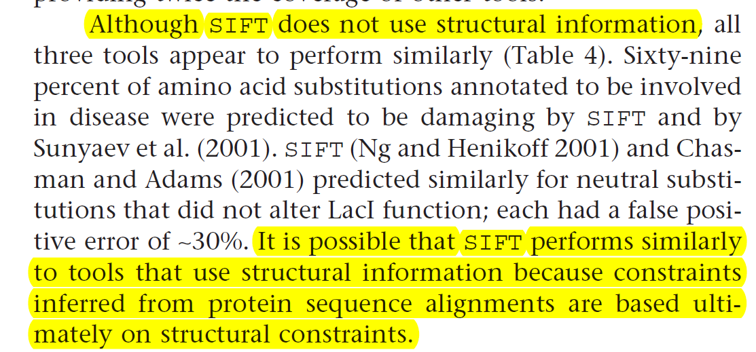
Ng and Heinkoff, Genome Research 12:436–446 ©2002

Slide 73
What we cannot use SIFT/PolyPhen for
Transcription, translation, splicing, other post-translational modifications

Slide 74
MutationTaster
http://www.mutationtaster.org/
Click on “Query Chromosome Positions”
Choose one variation from page 15 of this pptx

Slide 75
Useful Links
MutationTaster
http://www.mutationtaster.org/
SIFT
http://www.mutationtaster.org/
http://sift.bii.a-star.edu.sg/
Polyphen2
http://genetics.bwh.harvard.edu/pph2/
and many more

Slide 76
Thanks
Ravi
saka.ravi@gmail.com

